Slide 1
Financial Analysis
Do not save what is left after spending; spend what is left after saving.

Slide 2
INDEX
1. Introduction
2. Project Scope and Objectives
3. Key Financial Concepts and Functions
o Annuity o Present Value (PV)
o Net Present Value (NPV)
o XNPV
o EMI
o Interest and Principal Components of EMI
o Calculating Interest Rate
o Calculating Loan Term
o Internal Rate of Return (IRR)
o XIRR
o Modified IRR (MIRR)
4. Summary Report

Slide 3
Introduction
The purpose of this project is to provide fundamental insights into how financial functions and terminologies work in Excel.
it is essential to thoroughly understand the such as PV, NPV, XNPV, IRR, MIRR, and XIRR.
This project involves analyzing a prepared dataset and applying these financial functions to derive meaningful financial insights
Financial analysis helps us understand what money is worth and how to use it effectively.
Excel provides financial functions that help answer practical questions:
Payment decisions: Is it better to pay now or in installments?
Loan planning: How much must be paid each month?
Investment evaluation: Do future returns justify the initial cost?
Cash-flow timing: How does the timing of payments affect value?

Slide 4
Objectives and Scope
The project applies Excel functions to everyday financial decisions.
Compare payment options using present value.
Analyze loans using EMI, interest, principal, and repayment periods.
Evaluate investments using NPV, IRR, and MIRR.
Handle irregular cash flows using XNPV and XIRR.
Summarize findings with clear assumptions and practical recommendations.
Scope
Worked examples from the provided documentation. Investment comparisons requiring missing cash-flow tables remain illustrative.

Slide 5
Methodology and Approach
Organize the data: Enter loan amounts, rates, payments, cash flows, and dates.
Standardize time periods: Match monthly payments with monthly rates.
Select the function: Choose the formula that fits the financial question.
Validate the output: Check signs, payment timing, and closing balances.
Interpret the result: Explain what it means for the decision.

Slide 6
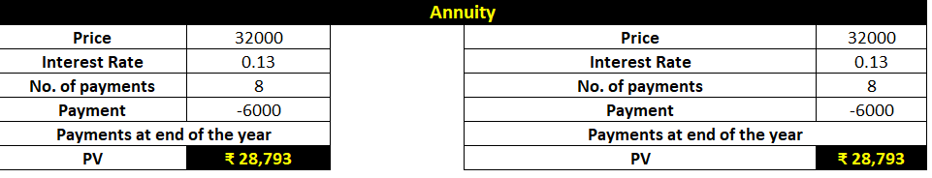
Cash-flow timing and sign conventions are essential.
Annuity
An annuity is a series of constant cash payments made over a continuous period, such as retire savings, insurance payments, or mortgage payments. In annuity functions:
A positive number represents cash received.
A negative number represents cash paid out.

Slide 7
Present Value (PV)
The present value is the total amount that a series of future payments is worth now.
Excel Function: PV =PV(rate, nper, pmt, [fv], [type])
rate: Interest rate per period.
nper: Total number of payment periods
. pmt: Payment made each period.
fv: Future value (optional). Type: Payment type (0 for end of period, 1 for beginning of period).

Slide 8
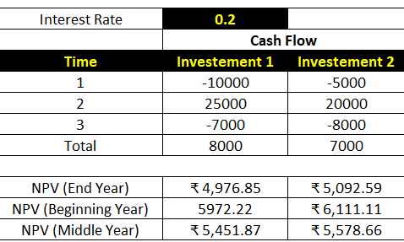
Net Present Value (NPV)
NPV calculates the net present value of an investment based on a discount rate and a series of future payments and incomes.
Excel Function: NPV =NPV(rate, value1, [value2], ...)
rate: Discount rate. • value1, value2, ...: Cash flows.
Example Investment with different cash flows: =NPV(10%, -1000, 300, 400, 500, 600)

Slide 9
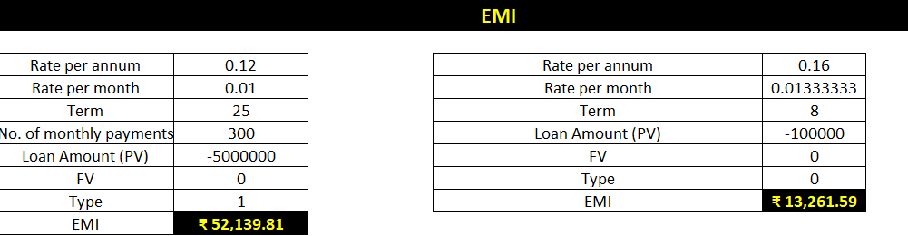
Equated Monthly Installment (EMI)
An EMI is a fixed payment amount made by a borrower to a lender at a specified date each calendar month.
Excel Function: PMT =PMT(rate, nper, pv, [fv], [type]) • rate: Interest rate per period
nper: Total number of payment periods.
pv: Present value or loan amount
fv: Future value (optional).
type: Payment type (0 for end of period, 1 for beginning of period).

Slide 10
Interest and Principal Components of EMI
To calculate the interest and principal parts of the EMI:
Interest Component: IPMT =IPMT(rate, per, nper, pv, [fv], [type])
Principal Component: PPMT =PPMT(rate, per, nper, pv, [fv], [type])
Calculating Interest Rate
To find the interest rate required to pay back a loan:
Excel Function: RATE =RATE(nper, pmt, pv, [fv], [type], [guess])
Example …. Loan amount: 100,000
Maximum monthly payment: 12,000
Loan term: 15 months
=RATE(15, -12000, 100000)

Slide 11
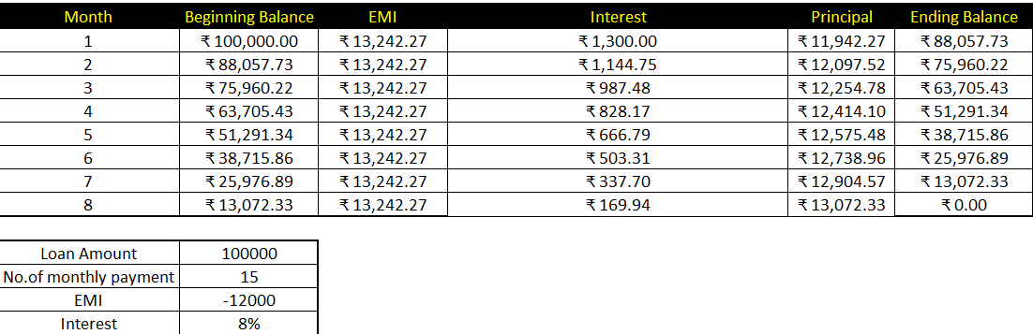
Calculating Loan Term
To determine the number of payments required to clear a loan:
Excel Function: NPER =NPER(rate, pmt, pv, [fv], [type])

Slide 12
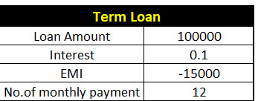
Example ..Loan amount: 100,000
Monthly payment: 15,000
Interest rate: 10%
=NPER(10%/12, -15000, 100000)
Internal Rate of Return (IRR)
IRR is the rate of interest at which NPV is zero.
Excel Function: IRR =IRR(values, [guess])
values: Cash flows.
guess: Initial guess (optional).
Example Calculate IRR for given cash flows: =IRR(A1:A5)

Slide 13
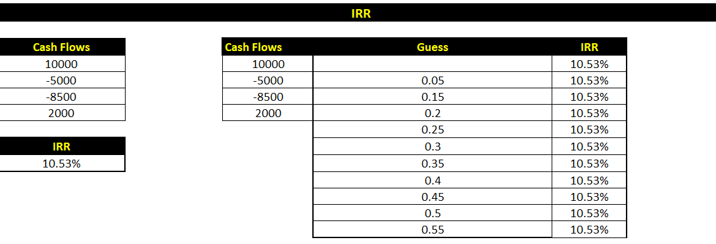

Slide 14
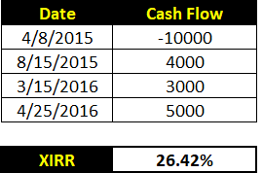
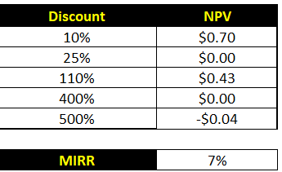
XIRR
To calculate the IRR for irregularly spaced cash flows:
Excel Function: XIRR =XIRR(values, dates, [guess])
Modified IRR (MIRR)
MIRR takes into account different finance and reinvestment rates.
Excel Function: MIRR =MIRR(values, finance_rate, reinvest_rate)

Slide 15
Summary Report Insights and Analysis
Annuity: Understood the concept of constant cash payments over time.
Present Value (PV): Learned to calculate the current worth of future payments.
Net Present Value (NPV) and XNPV: Compared different investments based on future cash flows.
EMI: Determined the monthly installment for a loan and its components.
Interest Rate and Loan Term: Calculated the effective interest rate and the duration required to repay a loan.
Internal Rate of Return (IRR) and Modified IRR (MIRR): Assessed the profitability of investments considering different cash flow timings and rates.
The project provided a comprehensive understanding of financial functions in Excel, enabling effective financial analysis and decision-making.

Slide 16
CONCLUSION
Excel provides financial functions that help answer practical questions:
Payment decisions: Is it better to pay now or in installments?
Loan planning: How much must be paid each month?
Investment evaluation: Do future returns justify the initial cost?
Cash-flow timing: How does the timing of payments affect value
The project provided a comprehensive understanding of financial functions in Excel, enabling effective financial analysis and decision-making.

